Slide 1
ACCY577 Machine Learning for Accounting
Module 3: Fundamental Algorithms II
Linden Lu

Slide 2
Lesson 1: K-nearest Neighbors
Supervised learning
Classification and regression
Predict with class/value of K nearest neighbors
No model built(memory demanding)
Feature Scaling is important

Slide 3
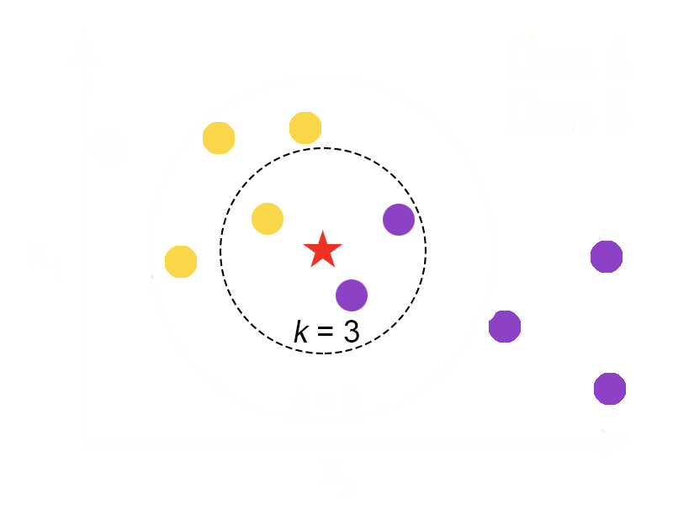
K-nearest Neighbors

Slide 4
Distance Measurement
Euclidean
Manhattan
Minkowski

Slide 5
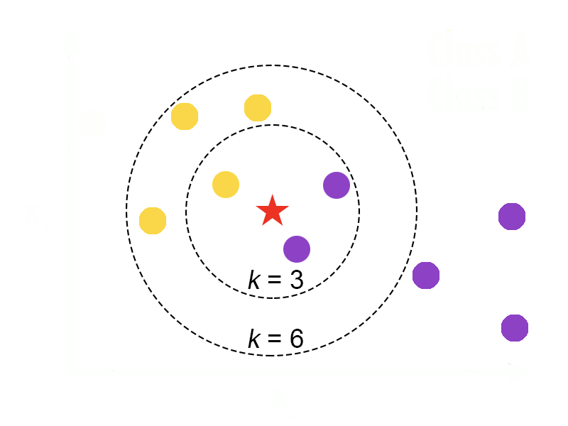
Choose Proper K
Can’t be too small
Can’t be too large
Better be odd

Slide 6
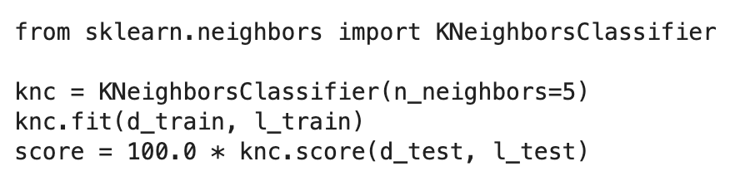
Scikit Learn K-nearest Neighbors Model
Hyperparamters
n_neighbors: Number of neighbors to use, default is 5.
metric : the distance metric to use. The default metric is 'minkowski'.
KNeighborsClassifier model

Slide 7
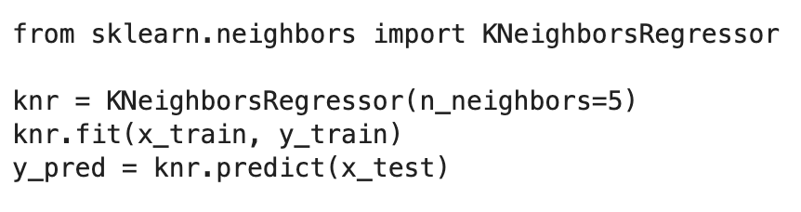
KNeighborsRegressor model

Slide 8
Lesson 2: Support Vector Machine
Supervised learning
Classification and regression
Performs classification by finding the hyperplane that maximizes the margin between the two classes
Feature scaling is important

Slide 9
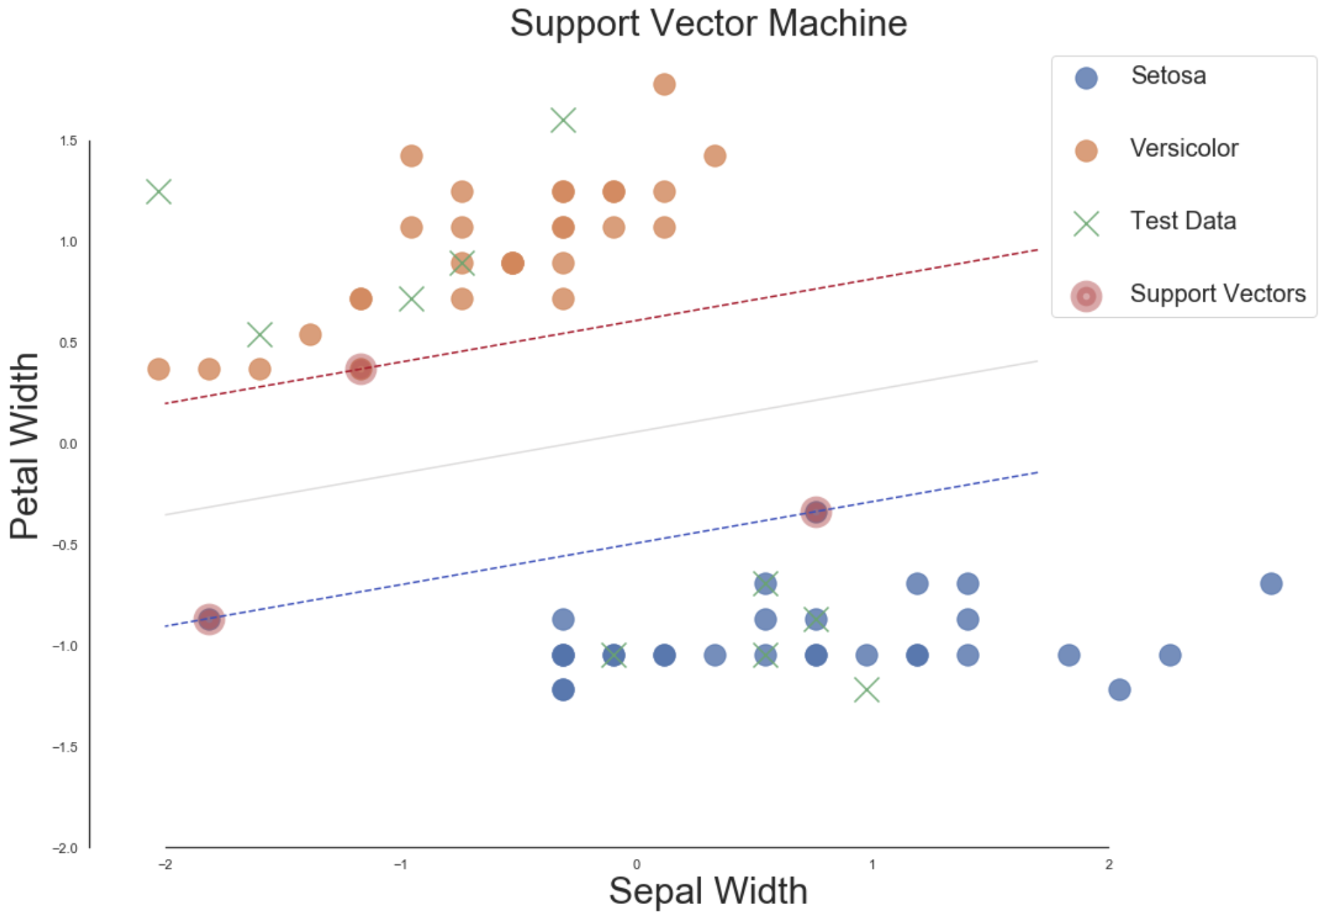
Support Vector Machine

Slide 10
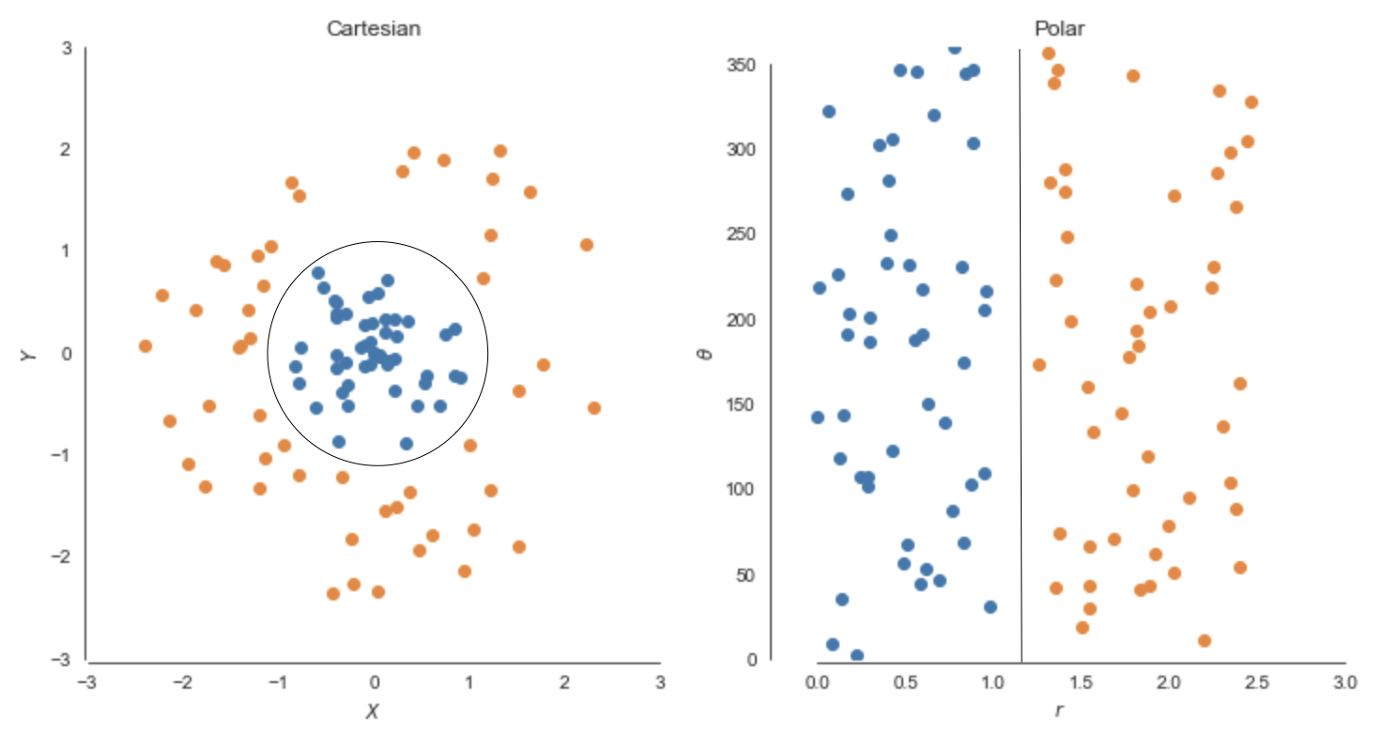
Support Vector Machine Kernel
Support Vector Machine Kernel
linear
rbf: radial basis function

Slide 11
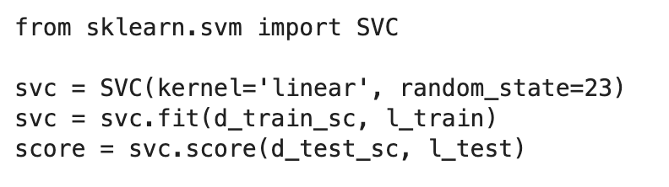
Scikit Learn SVC model

Slide 12
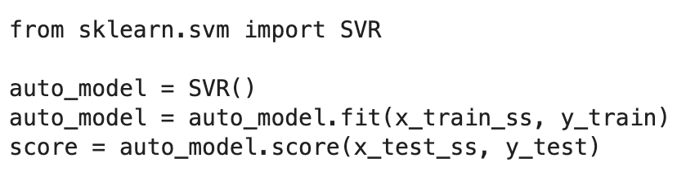
Scikit Learn SVR model

Slide 13
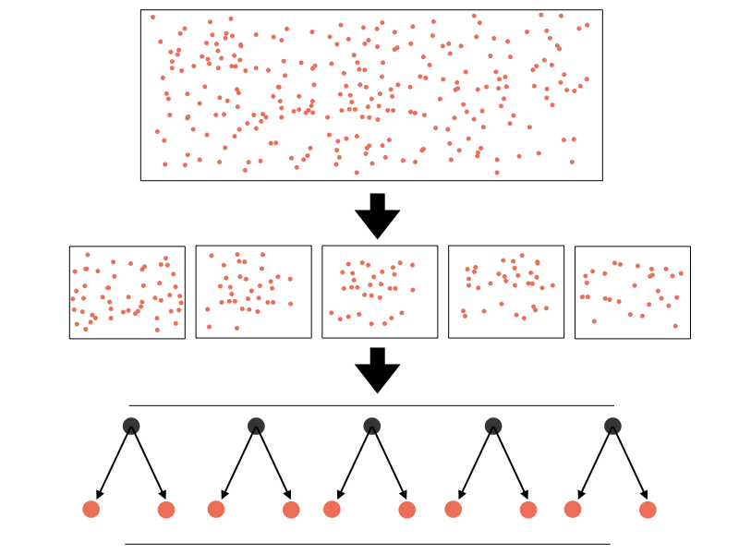
Lesson 3: Bagging and Random Forest
Bagging

Slide 14
Random Forest
Supervised learning
For both classification and regression problems
Can handle categorical feature(numerical)
Feature scaling is not needed

Slide 15
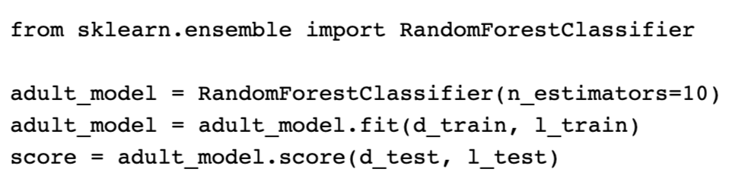
Scikit Learn Random Forest Classifier

Slide 16
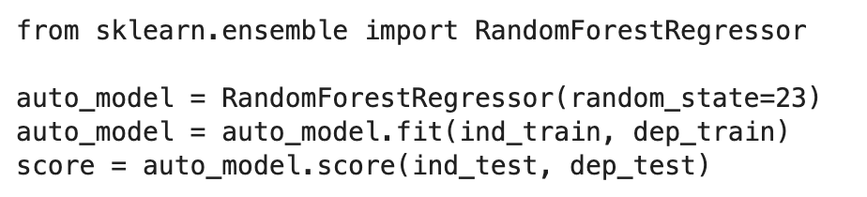
Scikit Learn Random Forest Regressor

Slide 17
Module 3 Review
K-nearest Neighbors
Support Vector Machine
Random Forest

Slide 18
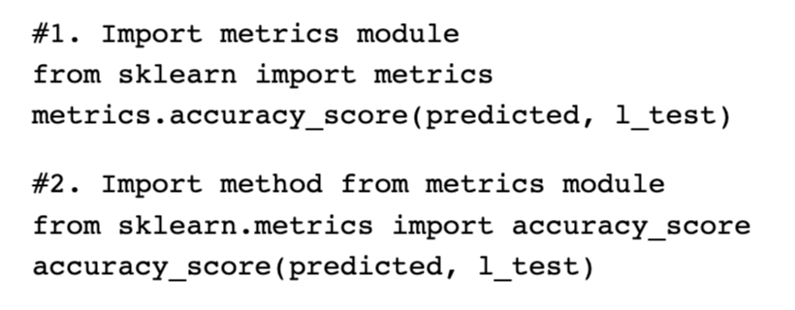
Module 3 Assignment Review

